Slide 1

Basic Details of the Team and Problem Statement
Ministry/Organization Name/Student Innovation:
PS Code:
Problem Statement Title:
Team Name:
Team Leader Name: Institute Code (AISHE):
Institute Name:
Theme Name:
Ministry of Law and Justice
1281
Development of gamified platform on Children's Rights to increase legal literacy and awareness among children in India
The InnoVisionaries
Malya Manohar
C-61216
Government Engineering College, Vaishali
Smart Education

Slide 2








Idea/Approach Details
Use Cases :
Dependencies :
To spread awareness about Children’s Rights
For Children Empowerment
For Education Purpose
IDE (Integrated Development Environment)
Database Management
Art & Design
UI / UX
3D Simulation
Programming Languages
Describe your idea/Solution/Prototype here:
Our Idea focuses on Empowering Children Through Gamified Learning and making them aware about their Child Rights.
As concentration of children are loosing day-by-day so Introducing Gamification in Education can make the learning more interactive and fun active.
This can revolutionize the learning.
So there will be a game whose levels will describe the various Children Rights and there will be obstacles (in the form of questions) in every level to make the game attractive.
Link for the prototype of our game : https://www.gamemaker3d.com/editor/temp/650a73b765a6a/TheInnoVisionariesPrototype.apk
Unique Features :
Interactive Learning
Education
Interactive User Interface
Describe your Technology stack here:

Slide 3
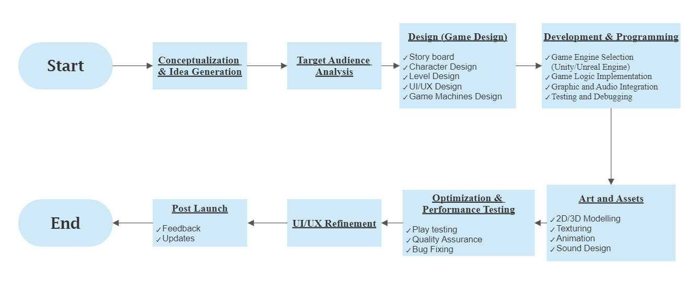
Idea/Approach Details
Flow Chart :

Slide 4
Team Member Details
Team Leader Name: Malya Manohar
Branch (Btech) Stream (ECE) Year (II)
Team Member 1 Name: Vartika Shikha
Branch (Btech) Stream (ECE) Year (II)
Team Member 2 Name: Avinash Goyal
Branch (Btech) Stream (ECE) Year (II)
Team Member 3 Name: Subham Kumar
Branch (Btech) Stream (ECE) Year (II)
Team Member 4 Name: Anurag Kashyap
Branch (Btech) Stream (ECE ) Year (II)
Team Member 5 Name: Aditya Kumar
Branch (Btech) Stream (ECE) Year (II)
Team Mentor 1 Name: Sinjan Kumar
Category (PhD) Expertise : Virtual Reality (VR) Domain Experience : On Going
Team Mentor 2 Name: Type Your Name Here
Category (Academic/Industry): Expertise (AI/ML/Blockchain etc): Domain Experience (in years):

